Slide 1


LEGUS 13.06.2024, Aachen – NIS 2.0

Slide 2






Attorney - Partnerr
Certified DPOr
Guest Lecturer
Author
Mr. Maarten Verhaghe

Slide 3

IT
IP
Data Protection
Cybersecurity

Slide 4

NIS 2.0
01
EU Cyber Strategy
mr. Maarten Verhaghe

Slide 5

EU Cyber Strategy 2013
NIS 2.0
“An Open, Safe and Secure Cyberspace”
EU statement
Brussels dd. 7 February 2013
Resilient digital information systems
User awareness
Improved coordination between::
  Member States
  Legal and enforcement agencies
  Public and private stakeholders
Strengthening cybersecurity and defence policy in the EU
➔ NIS Directive and Cybersecurity Regulation
Dia 5
mr. Maarten Verhaghe

Slide 6
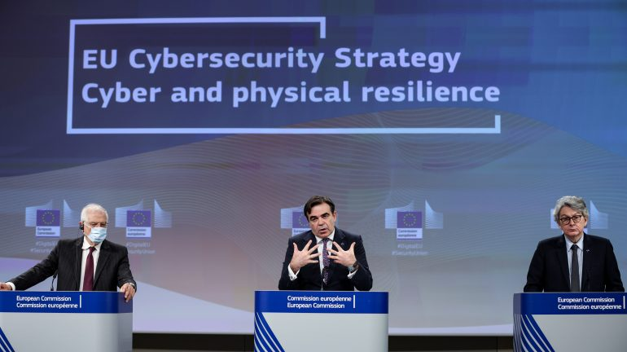
EU Cyber Strategy 2020
NIS 2.0
“Integrate cybersecurity into every element of the supply chain and bring further together EU's activities and resources across the four communities of cybersecurity – internal market, law enforcement, diplomacy and defence”
EU statement
Brussels dd. 16 December 2020
Dia 6
mr. Maarten Verhaghe

Slide 7
EU Cyber Strategy 2020
NIS 2.0
Increasing cyber and physical resilience
  Adaptation of legislative framework after review
    Update NIS Directive
    New directive for resilience of critical entities (extension directive 2008)
  Cybersecurity of Internet of Things (IoT)
  Cybersecurity shield in the EU
    Establishment of Security Operations Centres
    Powered by AI
    Early detection of cyber-attacks and enabling proactive attacks
    Avoiding damage
  Responding to major attacks
  Global collaboration to ensure security and stability in cyberspace
➔ NIS 2.0 Directive and Cyber Resilience Regulation
Dia 7
mr. Maarten Verhaghe

Slide 8
NIS 2.0
02
NIS2 Directive
mr. Maarten Verhaghe

Slide 9
Material Scope of Application
NIS 2.0
  Measures aimed at achieving a high common level of cybersecurity in the EU.
  Security of network and information systems (art. 6.1 en 6.2 NIS2 Directive):
  ‘network and information system’:
  an electronic communications network as defined in Article 2, point (1), of Directive (EU) 2018/1972;
  any device or group of interconnected or related devices, one or more of which, pursuant to a programme, carry out automatic processing of digital data; or,
  digital data stored, processed, retrieved or transmitted by elements covered under points (a) and (b) for the purposes of their operation, use, protection and maintenance;
  ‘security of network and information systems’:
  The ability of network and information systems to resist, at a given level of confidence, any event that may compromise the availability, authenticity, integrity or confidentiality of stored, transmitted or processed data or of the services offered by, or accessible via, those network and information systems,
Dia 9
mr. Maarten Verhaghe

Slide 10
Personal Scope of Application
NIS 2.0
  Expansion of the scope of NIS1
    New sectors included under the scope
    Based on NACEBEL-Codes – registration in the CBE (KBO)
      Postal and courier services
      Waste management
      Production and distribution of chemical substances/food products
      Manufacturing of medical devices, ICT products, electrical equipment, etc.
      Public authorities (including local and education, if decided by the Belgian legislator)
      Critical infrastructures in accordance with Directive 2022/2557
      ICT manager and ICT security manager
    Entities with more than 50 employees or an annual turnover (or annual balance sheet total) exceeding 10 million euros
Dia 10
mr. Maarten Verhaghe

Slide 11
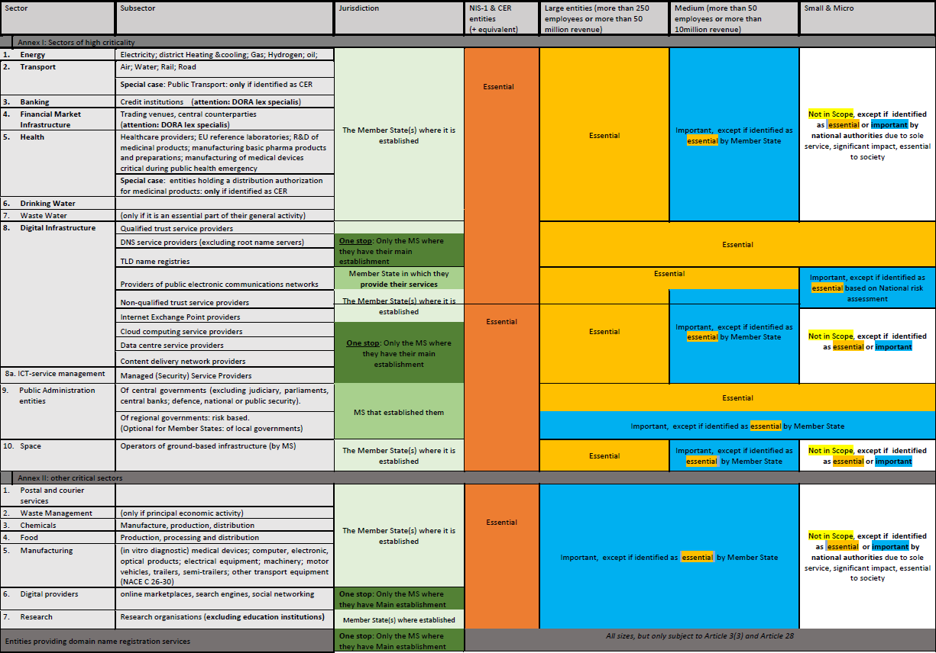
Scope Art. 2 and 3 NIS2 Directive
NIS 2.0
Dia 11
mr. Maarten Verhaghe

Slide 12
Designation by the legislator?
NIS 2.0
  NIS2 Bill provides for the possibility of identification
    Designation of new NIS2 entities
    Designation new NIS2 sectors
    Expansion of existing sectors using NACEBEL-codes
  Evaluation of identification
    Biannual
Dia 12
mr. Maarten Verhaghe

Slide 13
How to determine whether a company falls under the scope?
NIS 2.0
  Audit (legal)
    Review of the company’s current activities
    Screening partner- and associated company’s
    Screening of the company’s future activities
    Analysis of turnover and employees
    Desgination by the legislator
  Know Your Customer → Supply chain security
    Direct NIS2 customers
    Indirect NIS2 customers (sub-suppliers)
Dia 13
mr. Maarten Verhaghe

Slide 14
NIS 2.0
03
NIS2 - Obligations
mr. Maarten Verhaghe

Slide 15
NIS 2.0
Duty of care:
Security policy
Secure infrastructure
Contractual arrangements
Technical and organizational measures
certification
Duty to report:
Cyber incidents
Cyber threats
Data breaches (GDPR)
“Ongoing obligation of means”
Obligation to continuously evaluate and update measures
Dia 15
mr. Maarten Verhaghe

Slide 16
Governance: Art. 20 NIS2 Directive
NIS 2.0
  Awareness and liability
    Obligation to supervise the implementation of cybersecurity measures
    Governing bodies responsible for non-compliance with the obligations as specified in article 21 et seq. of the NIS2 Directive
    Regularly attend specific training courses to acquire sufficient knowledge and skills to identify and assess risks and management practices in the field of cybersecurity and their impact on the entity's activities.
    Similar training for employees to enable them to identify risks and assess their consequences.
Dia 16
mr. Maarten Verhaghe

Slide 17
Measures for Cyber Risks: Art. 21 NIS2 Directive
NIS 2.0
  Adoption of appropriate, proportionate technical and organizational measures: broad formulation
    Taking into account the state of the art
    Measures tailored to the risk, but at least the following:
      Policy for risk analysis and security of information systems
      Incident handling
      Business continuity (backup management, emergency provision, and crisis management)
      Security of the supply chain (Art. 24 NIS2 Directive)
      Security in the acquisition, development, and maintenance of network and information systems
      Policy and procedures for encryption
      Policy and procedures to assess the effectiveness of measures
      Security aspects concerning personnel, access policies
      Multi-factor authentication
Dia 17
mr. Maarten Verhaghe

Slide 18
Risk Management Measures: Art. 21 NIS2 Directive
NIS 2.0
  Specific measures or guidelines?
    By the 17th of October 2024, the EU Commission will propose implementing acts for:
      DNS service providers
      Cloud computing
      Data centers
      Hosting
      ICT manager and ICT security manager
      Online marketplaces
      Social media
      Trust services
Dia 18
mr. Maarten Verhaghe

Slide 19
Risk Management Measures: NIS2 Bill
NIS 2.0
  Cybersecurity policy?
    A physical or digital document
      Creation of a risk analysis considering all hazards.
        Network and IT systems
        Physical environment of Network and IT systems
      Protection and safety measures
      At least include everything stated in Article 21 of the NIS2 Directive
Dia 19
mr. Maarten Verhaghe

Slide 20
Supply Chain Security
NIS 2.0
  Legal obligation?
    Article 7 and 21.3 of the NIS2 Directive:
      Member States shall establish policies on cybersecurity in the supply chain for ICT products and services used by entities to provide their services
        The procurement options for NIS2 entities will be limited.
        Suppliers will have to conform to NIS2 and meet a high level of cybersecurity.
        Contractual arrangement for cybersecurity (for suppliers).
        Also with regards to suppliers outside the scope of NIS2.
Dia 20
mr. Maarten Verhaghe

Slide 21
Supply Chain Security
NIS 2.0
        Consideration 85 NIS2 Directive:
        “Essential and important entities should therefore assess and take into account the overall quality and resilience of products and services, the cybersecurity risk-management measures embedded in them, and the cybersecurity practices of their suppliers and service providers, including their secure development procedures.
        Essential and important entities should in particular be encouraged to incorporate cybersecurity risk-management measures into contractual arrangements with their direct suppliers and service providers. Those entities could consider risks stemming from other levels of suppliers and service providers.”
Dia 21
mr. Maarten Verhaghe

Slide 22
Supply Chain Security
NIS 2.0
  Supplier Assessment?
    Article 21.3 NIS2 Directive:
      Screening of (sub-)suppliers and service providers
        Taking into account specific vulnerabilities.
        General quality of cybersecurity practices of products.
        Secure development procedures for products and services.
      Similar to “vendor-assessment” under the GDPR (art. 28.1 GDPR)
        “…, the controller shall use only processors providing sufficient guarantees to implement appropriate technical and organisational measures…”
Dia 22
mr. Maarten Verhaghe

Slide 23
Supply Chain Security: NIS 2 Bill
NIS 2.0
  Screening sub-suppliers confirmed?
    “When essential and significant entities consider which measures referred to in paragraph 3(4) are appropriate, they shall take into account the specific vulnerabilities of each direct supplier and service provider and the overall quality of the products and cybersecurity practices of their suppliers and service providers, including their secure development procedures.”
    Obligation under Belgian Bill
    Analysis of vulnerabilities
    Security measures
    Contractual guarantee
Dia 23
mr. Maarten Verhaghe

Slide 24
Supply Chain Security
NIS 2.0
  Contractual addition?
    Article 21.3 and recital 85 NIS2 Directive:
      Double obligation:
        Contractual arrangement (pay attention: national legislation and IPR)
          Risk assessment information security policy
          Audit regulation
          Procedures regarding incident report
          Emergency recovery and measures
          Warranties and declarations of conformity
          State of the art security measures
          ISO 27001 and 27002 as a minimum
        Declaration of conformity: regarding suppliers / customers
      Drafting supplier evaluation
Dia 24
mr. Maarten Verhaghe

Slide 25
Conformity assessment: Belgian Bill NIS2
NIS 2.0
  Regular conformity assessment?
    Essential entities
      2 possibilities:
        Assessment by a Conformity assessment body designated by CCB
          Assessment against CCB reference framework
          ISO 27001
        Check by inspection service CCB
          Retribution fixed in draft RD
Dia 25
mr. Maarten Verhaghe

Slide 26
NIS2 compliance? : Belgian Bill NIS2
NIS 2.0
  Regular conformity check by assessment body
  Presumption of compliance
    Until proven otherwise
      Essential entities:
      Important entities, on a voluntary basis
        ISO 27001 is a minimum
Dia 26
mr. Maarten Verhaghe

Slide 27
Duty to report: Art. 23 NIS2 Directive
NIS 2.0
  Essential and important entities:
    Reporting significant incident and threats (where applicable) to their customers (art. 23.1 and 2 NIS 2 Directive)
    Reporting of significant incidents (art. 23.3 NIS 2 Directive)
      “(a) it has caused or is capable of causing severe operational disruption of the services or financial loss for the entity concerned;
      (b) it has affected or is capable of affecting other natural or legal persons by causing considerable material or non-material damage.”
  The EU Commission will only specify on October 17, 2024 the cases in which an incident should be considered “significant” for ICT service providers (service providers as security service operators).
Dia 27
mr. Maarten Verhaghe

Slide 28
Duty to report: Art. 23 NIS2 Directive
NIS 2.0
  Current framework NIS1 Directive
    NIS 1 assessment: the availability, confidentiality, integrity or authenticity of the network and information systems on which the essential service or services it provides depend
    Or:
Duration of the incident Unavailability for more than 5,000,000 user hours | The term 'duration' refers to the time span from the moment the service no longer functions properly in terms of availability, authenticity, integrity, or confidentiality, to the moment of full restoration of the service; The term 'user hour' refers to the number of users in the European Union affected for a time span of twenty minutes. | Nature of the impact Risk to public security or Risk to public safety or Has led to a risk of loss of human life | The DSP can determine the nature of the impact based on indicators such as the nature of its contractual involvement with the client or, if applicable, the potential number of affected users
Number of users More than 100,000 affected users | Included in the ‘users’ of digital services are all natural persons and legal entities who are customers or subscribers to an online marketplace or cloud computing service, or who perform searches on the website of an online search engine by entering search terms. | Material damage Caused damage > €1,000,000 | The incident causes >€1,000,000 damage to at least one user in the European Union
Dia 28
mr. Maarten Verhaghe

Slide 29
Duty to report: Art. 23 NIS2 Directive
NIS 2.0
  Essential and important entities:
    Incident reporting
      To the CSIRT or competent authority
      Without delay and at the latest within 24 hours in case of suspicion of malicious intent or cross-border impact
      Update without delay and at the latest within 72 hours
      Draft interim reports and a final report no later than one month after notification
      Communication to the public by CSIRT or competent authority or concerned entity
Dia 29
mr. Maarten Verhaghe

Slide 30
Presumption of compliance: Art. 24 NIS2 Directive
NIS 2.0
  Cybersecurity certification (art. 24 NIS2 Directive)
  Presumption of compliance with security obligation
  Member States may impose specific certification
  Cybersecurity Regulation
  Distinction with NIS1 ➔ ISO 27001 presumption of compliance with AED (not DDV)
  Cf. combination with supply chain security (art. 21 NIS2 Directive).
Dia 30
mr. Maarten Verhaghe

Slide 31
Beware: NIS2 on public procurement?
NIS 2.0
  Local authorities may be governed by NIS2 (art. 2.5 NIS2 Directive)
    National legislator decides at the end of 2024
  Cybersecurity requirements for ICT products and ICT services
    Tendering procedures
    Specific requirements
    Certification
    Encryption
    Use of open source
Dia 31
mr. Maarten Verhaghe

Slide 32
How to be NIS 2 compliant?
NIS 2.0
Legal
Compliance
Cyber
  Cybersecurity audit
    Analyse security
    Determining crown jewels
  Legal audit
    Know your customer
    Risk assessment suppliers + suppliers' chain
    Assessment of existing contract (own + suppliers)
  Drafting contractual framework
    Vendor assessment
    Contractual provisions regarding notification, audit, guarantees, security measures …
  Compliance
    ISO 27001 and 27002
    Incident Response Plan and Business Continuity plan
    Security policy
    Awareness sessions
Dia 32
mr. Maarten Verhaghe

Slide 33
NIS 2.0
04
NIS2 Enforcement
mr. Maarten Verhaghe

Slide 34
Monitoring and enforcement: Art. 31 - 33 NIS2 Directive
NIS 2.0
  Competent authorities + cooperation with DPA
    Inspections on-site
    Audits
    Security scans
    Information requests
    Requests for access / data / documents / information
    Request proof of cybersecurity policy
Dia 34
mr. Maarten Verhaghe

Slide 35
Corrective measures: Art. 32 -33 NIS2 Directive
NIS 2.0
  Supervisory authority has extensive capabilities:
    Imposing corrective measures → periodic penalty payment?
    Ordering: only purchasing ICT products / services / processes if subject to certification
    Ordering: only developing certified ICT products / services / processes
Dia 35
mr. Maarten Verhaghe

Slide 36
Sanctions: Art. 32 and 33 NIS2 Directive
NIS 2.0
  Competent authorities + cooperations with DPA
    Issuing warnings
    Adopt binding instructions
    Order to cease conduct
    Designate monitoring officer for a determined period of time
    Making public and publication
    Administrative fine of at least EUR 10.000.000 / 2% worldwide turnover
    Administrative fine of at least EUR 7.000.000 / 1,4% worldwide turnover
    Suspend certifications
Dia 36
mr. Maarten Verhaghe

Slide 37
Liability: Art. 32 and 33 NIS2 Directive
NIS 2.0
“Member States shall ensure that any natural person responsible for or acting as a legal representative of an essential entity on the basis of the power to represent it, the authority to take decisions on its behalf or the authority to exercise control of it has the power to ensure its compliance with this Directive. Member States shall ensure that it is possible to hold such natural persons liable for breach of their duties to ensure compliance with this Directive.”
  Also, important entities (art. 33 NIS 2 Directive)
  Directors
  Board members (CFO, CISO …)
  Confirmed in Belgian Bill NIS 2
Dia 37
mr. Maarten Verhaghe

Slide 38
Possibilities to file a complaint?
NIS 2.0
  No legal framework foreseen in NIS2 Directive
    But!
    Directive: minimum harmonisation
      Complaint likely possible at Inspection Services
        Health care: FPS Public health
        Energy: FPS Economy
        ICT/digital services: FPS Economy
        Other important sectors: FPS Economy
    Belgian Bill NIS2
      Notification of potential security risks to CSIRT
      Anonymously by natural or legal person
Dia 38
mr. Maarten Verhaghe

Slide 39
NIS 2.0
05
Can you prepare?
mr. Maarten Verhaghe

Slide 40
How to prepare?
NIS 2.0
Audit
Technical
Legal
Analyse
Crown jewels
Vendor assessment
Approach
Security measures
Contractual framework
Policies + reporting obligation
Compliance
Certification
Dia 40
mr. Maarten Verhaghe

Slide 41
Concerns:
NIS 2.0
  Security policy + measures
  Supply chain security
    Certification
    Contractual securities
  Incident management
    Technical / legally
    Reporting obligations + methodology (NIS + GDPR)
    Incident response plan
  Business continuity
  Best practice: ISO 27001 and 27002
Dia 41
mr. Maarten Verhaghe

Slide 42
Deadline?
NIS 2.0
  Temporal scope:
  Approved by EU Parliament: November 10th 2022
  Conversion to Belgian law: 18 months ➔ October 2024
  Minimum harmonisation
Dia 42
mr. Maarten Verhaghe

Slide 43




+32 9 277 70 20
maarten@trustadvocaten.be
www.trustadvocaten.be

